Slide 1
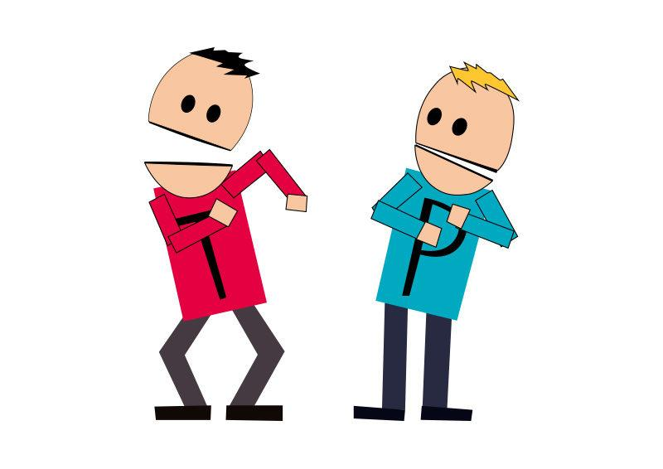
HI BUDDY
The App that helps track your hi

Slide 2


Is your activity feeling routine?
Boring
Habit
Gone too soon
Just down right not enjoyable

Slide 3

THERE’S AN APP FOR THAT……
…….Eventually

Slide 4


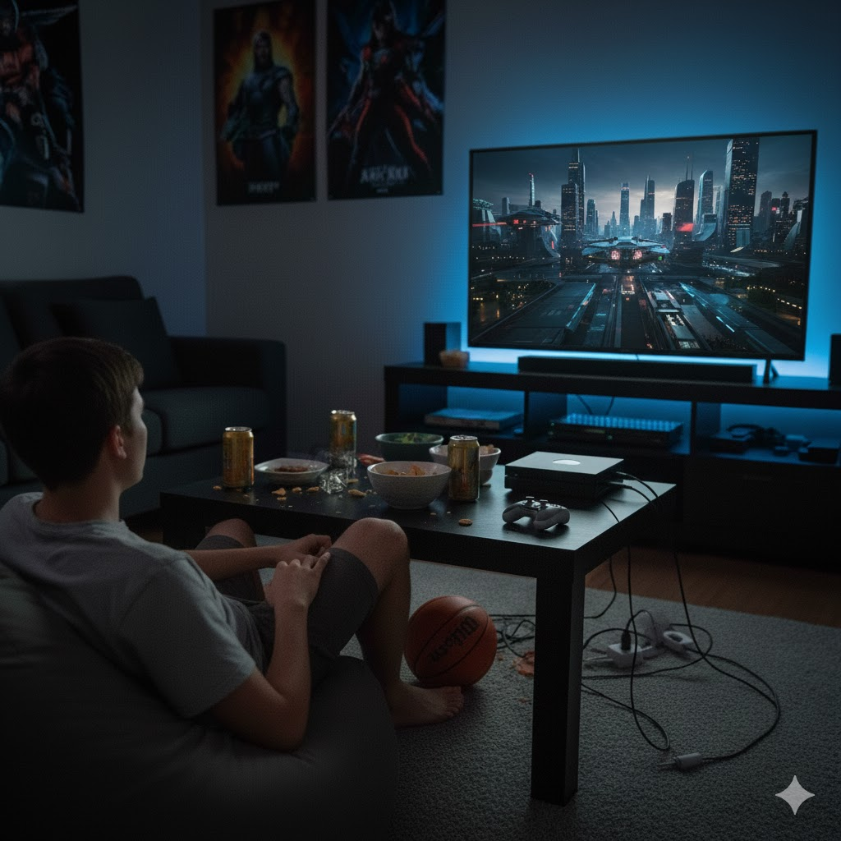
HI-BUDDY
The App helps track and optimise your Experience..
Matches your sparking activity with another activity.
Based off strain, history and mood
Gives A list of recommendations.

Slide 5

Who it affects and what does it need?
-The Hi-Buddy app is intended to help stoners, lazy and bored people, and party poopers.
-To properly run it needs user interaction and a base level of interaction from the patient. After all they are your buddy,guy.
- Needs to be able to pull from a multiple number of databases such as Video games, music and movies ( I don’t mean information but example: Netflix’s funny movie compared to Disney’s funny movie selection).

Slide 6
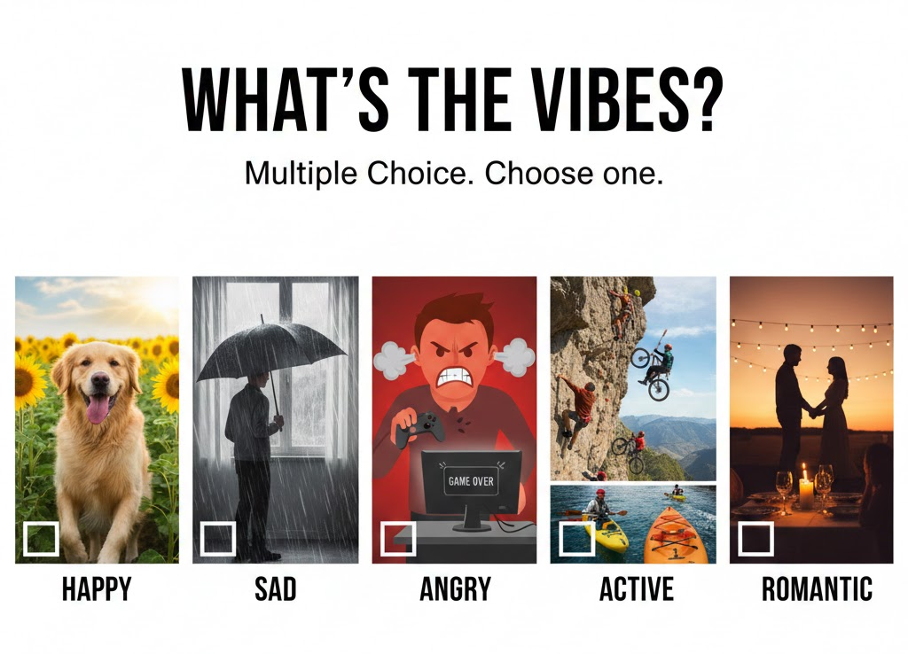
How it works?
You are presented with a box to choose your emotion or whatever is close to your emotion you are feeling.
#include <iostream>
#include <string>
using namespace std;
int main() {
string answer;
cout << "(1) Happy”\n;
cout << "(2) Sad”\n;
cout << "(3) Hyper”\n;
cout << "(4) Romantical”\n;
cout << "(5) Angry”\n;
cout << "Choose a mood: ";
cin >> answer;
cout << "You selected option: " << answer << "\n";
return 0;
}

Slide 7
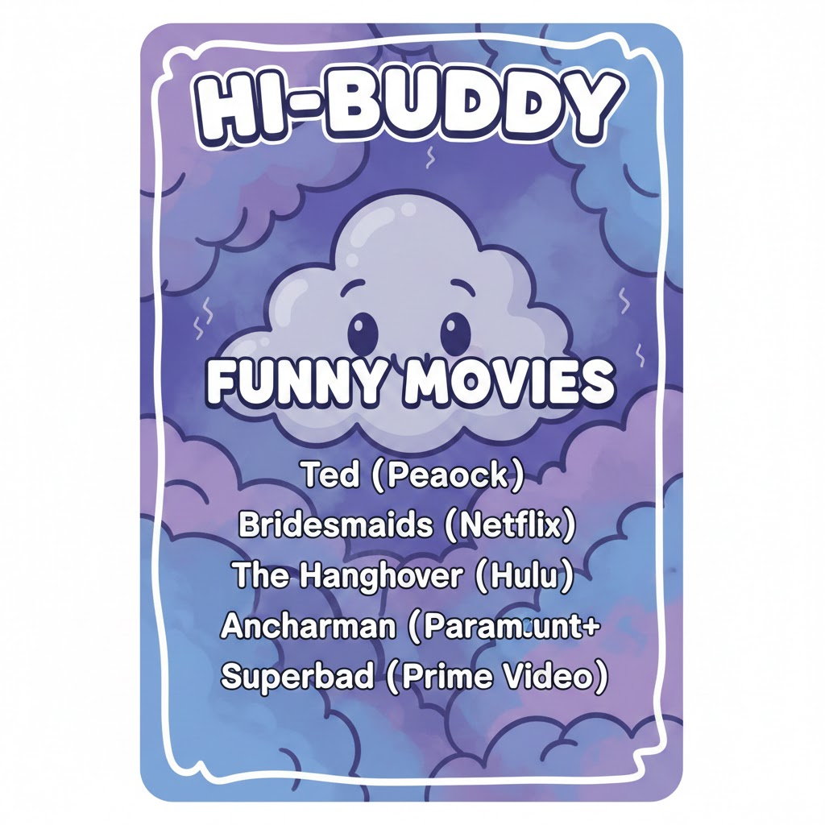
After, you are presented with Display a box of activities that matches with your mood, first to raise your hope meter is the one. (Swipe Left for no, Swipe Right for winner)
The Box has a main and under it are suggestions to try, based off previous user entries.
The goal is to get you to not be on the couch all day.

Slide 8
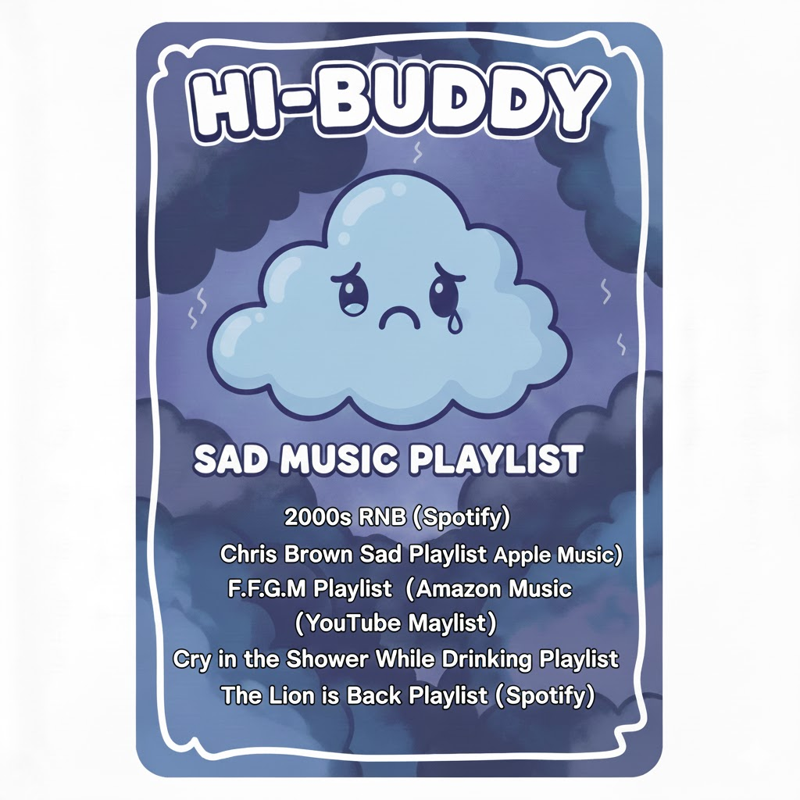
Pseudo No-jutsu
DISPLAY "----------------------------------"
DISPLAY " YOUR ACTIVITY BOX "
DISPLAY "----------------------------------"
IF mood_choice IS "1" THEN
DISPLAY "HI-BUDDY: FUNNY MOVIES"
DISPLAY "- Ted (Peacock)"
DISPLAY "- Bridesmaids (Netflix)"
// ... list continues for mood 1 ...
ELSE IF mood_choice IS "2" THEN
DISPLAY "SAD MODE: COMFORT ACTIVITIES"
DISPLAY "- Warm tea + blanket"
DISPLAY "- Soft music playlist"
// ... list continues for mood 2 ...
ELSE IF mood_choice IS "3" THEN
DISPLAY "HYPER MODE: ENERGY BOOSTERS"
DISPLAY "- Fun challenges"
// ... list continues for mood 3 ...
ELSE IF mood_choice IS "4" THEN
DISPLAY "ROMANTIC VIBES: LOVE MOMENTS"
DISPLAY "- Romantic movie"
// ... list continues for mood 4 ...
ELSE IF mood_choice IS "5" THEN
DISPLAY "ANGRY MODE: RELEASE ACTIVITIES"
DISPLAY "- Deep breathing"
// ... list continues for mood 5 ...
ELSE
DISPLAY "Invalid mood option."
END IF
DISPLAY "----------------------------------"
END FUNCTION
// Main execution block
FUNCTION Main()
DECLARE answer AS STRING
DISPLAY "Select your mood:"
DISPLAY "(1) Happy"
DISPLAY "(2) Sad"
DISPLAY "(3) Hyper"
DISPLAY "(4) Romantic"
DISPLAY "(5) Angry"
PROMPT "Choose mood number: "
INPUT answer
CALL ShowActivityBox(answer)
END FUNCTION
END PROGRAM

Slide 9
